Slide 1


模式识别与机器学习
Pattern Recognition & Machine Learning
郭玉柱
yuzhuguo@buaa.edu.cn
自动化科学与电气工程学院
脑机智能实验室
2019
Lecture Notes：
buaaprml@163.com
Password：prmlbuaa

Slide 2
Pattern Recognition
Typical application areas
  Machine vision
  Character recognition (OCR)
  Computer aided diagnosis
  Speech recognition
  Face recognition
  Biometrics
  Image Data Base retrieval
  Data mining
  Bionformatics
The task: Assign unknown objects – patterns – into
the correct class. This is known as classification.

Slide 3
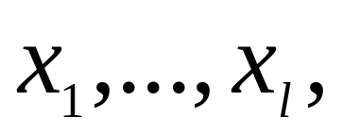
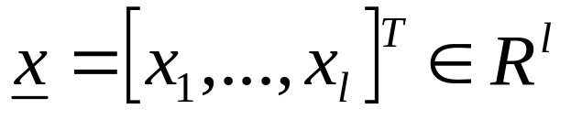
Pattern Recognition
  Features: These are measurable quantities obtained
  from the patterns, and the classification task is based
  on their respective values.
  Feature vectors: A number of features
constitute the feature vector
Feature vectors are treated as random vectors.

Slide 4


Pattern Recognition
The classifier consists of a set of functions, whose values, computed at , determine the class to which the corresponding pattern belongs
Classification system overview
Patterns
sensor
feature
generation
feature
selection
classifier
design
system
evaluation

Slide 5
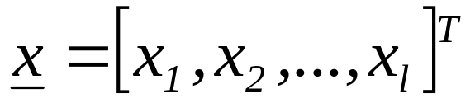
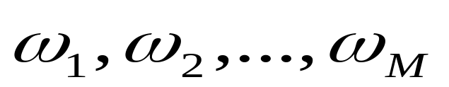
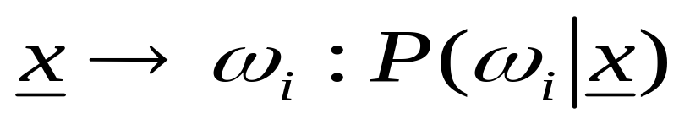
CLASSIFIERS BASED ON BAYES DECISION THEORY
Statistical nature of feature vectors
Assign the pattern represented by feature vector
to the most probable of the available classes
That is
maximum

Slide 6

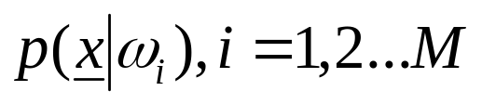
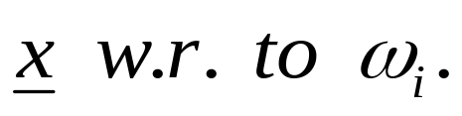
CLASSIFIERS BASED ON BAYES DECISION THEORY
Computation of a-posteriori probabilities
  Assume known
    a-priori probabilities
    This is also known as the likelihood of

Slide 7
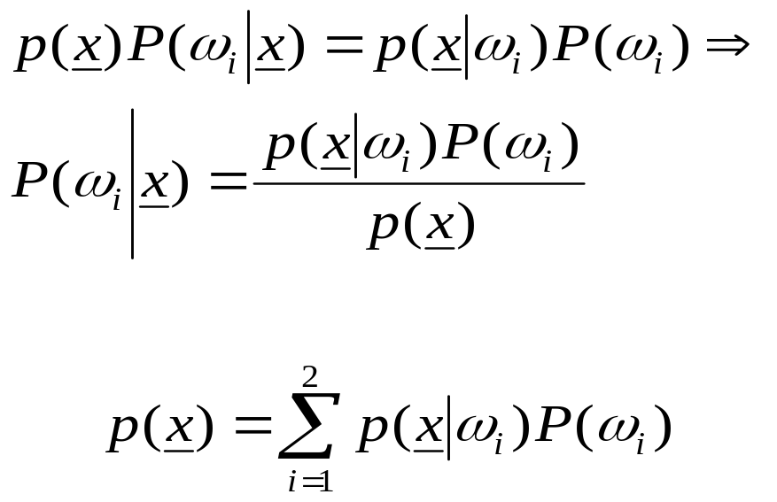
CLASSIFIERS BASED ON BAYES DECISION THEORY
  The Bayes rule (Μ=2)
where

Slide 8
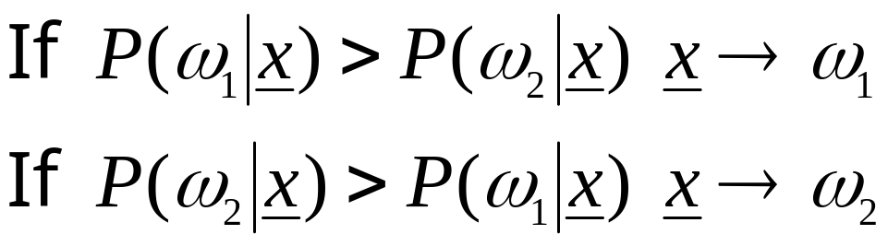
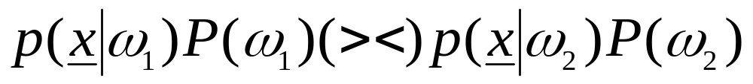
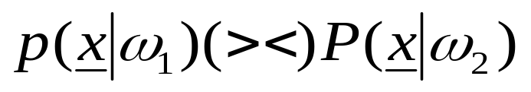
CLASSIFIERS BASED ON BAYES DECISION THEORY
The Bayes classification rule (for two classes M=2)
  Given x classify it according to the rule
  Equivalently: classify x according to the rule
  For equiprobable classes the test becomes

Slide 9
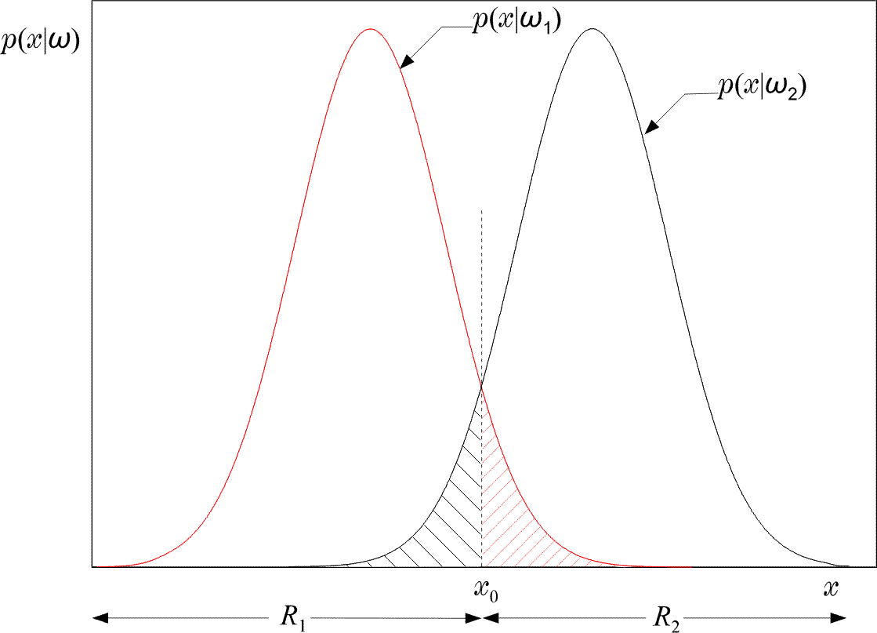
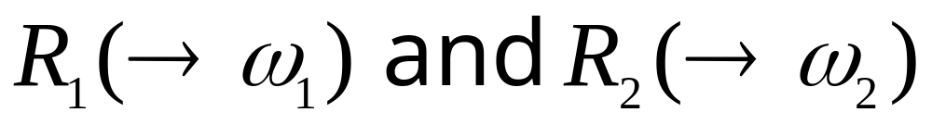
CLASSIFIERS BASED ON BAYES DECISION THEORY

Slide 10
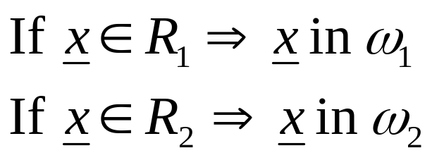
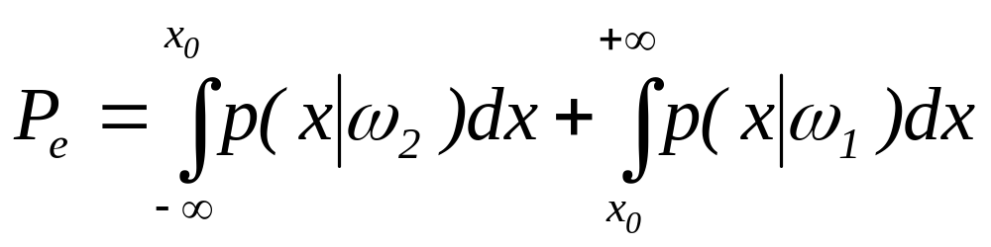
CLASSIFIERS BASED ON BAYES DECISION THEORY
Equivalently in words: Divide space in two regions
Probability of error
  Total shaded area
Bayesian classifier is OPTIMAL with respect to minimising the classification error probability!!!!

Slide 11
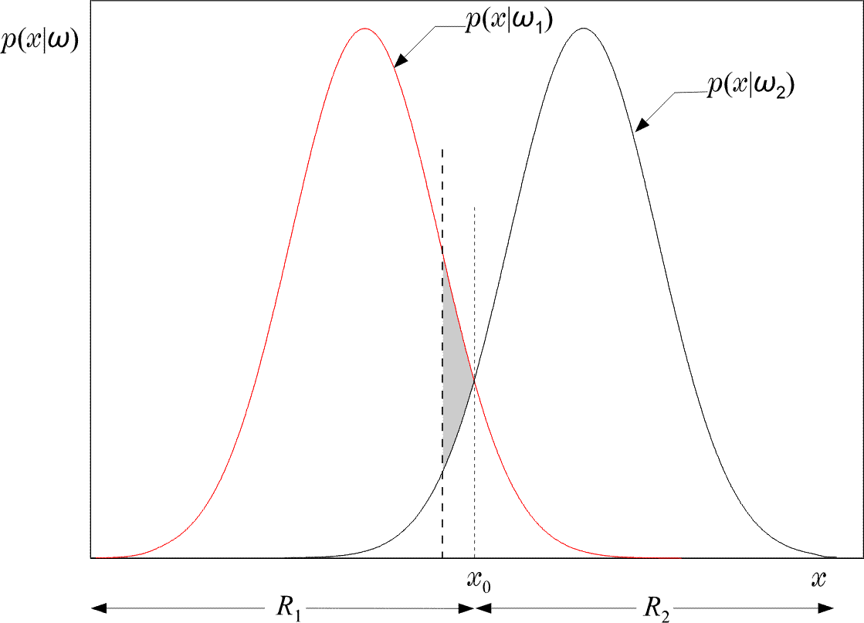
CLASSIFIERS BASED ON BAYES DECISION THEORY
  Indeed: Moving the threshold the total shaded area INCREASES by the extra “grey” area.

Slide 12
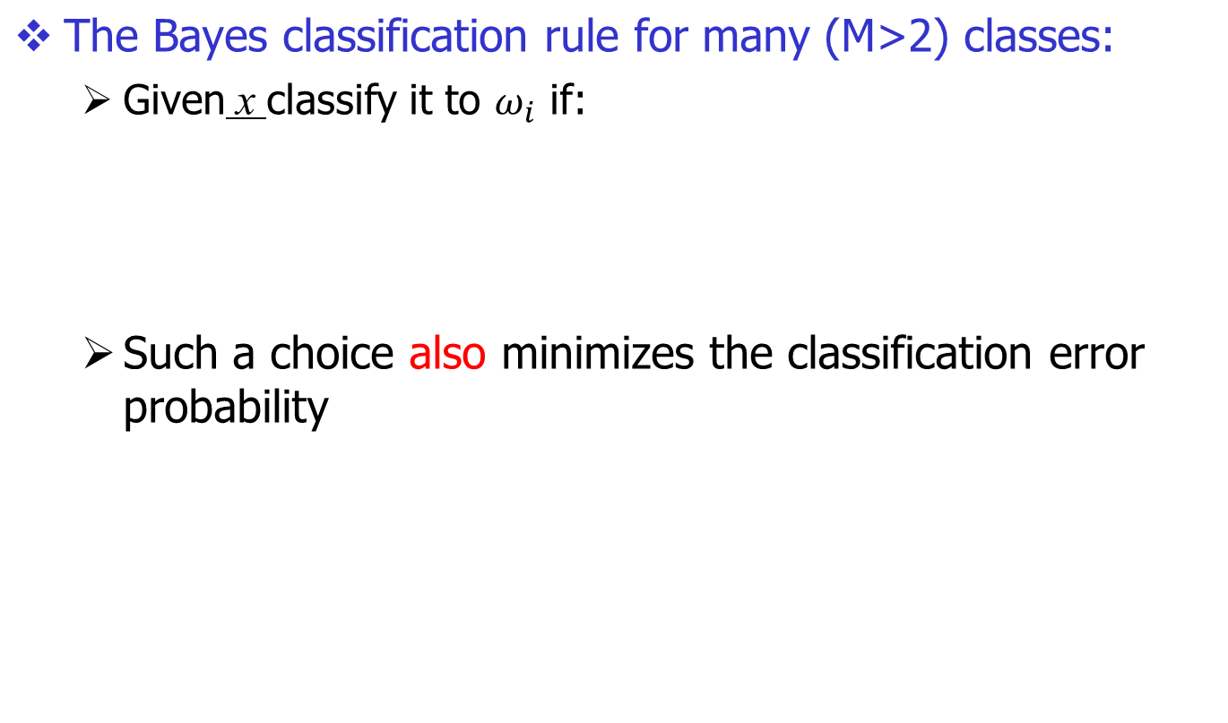
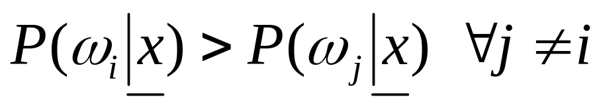
CLASSIFIERS BASED ON BAYES DECISION THEORY

Slide 13
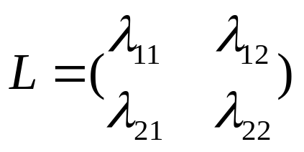

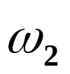

CLASSIFIERS BASED ON BAYES DECISION THEORY
Minimizing the average risk
  For each wrong decision, a penalty term is assigned since some decisions are more sensitive than others
  For M=2
    Define the loss matrix
    penalty term for deciding class ,
    although the pattern belongs to , etc.

Slide 14
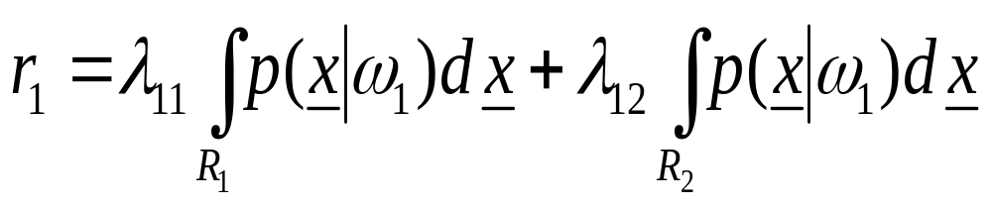
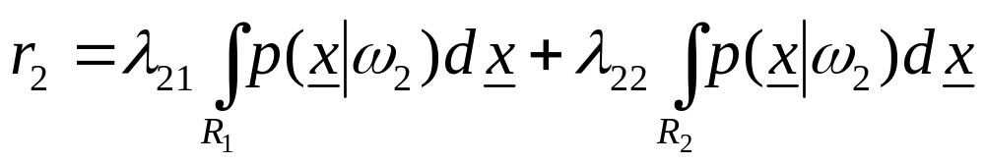

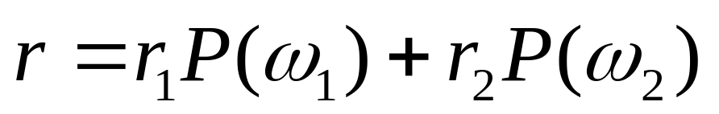
CLASSIFIERS BASED ON BAYES DECISION THEORY
  Risk with respect to
  Risk with respect to
  Average risk
Probabilities of wrong decisions, weighted by the penalty terms

Slide 15



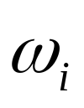
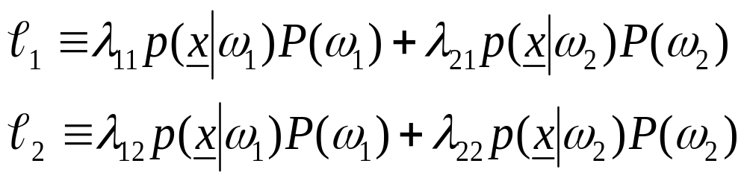
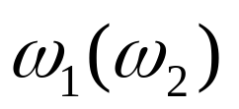
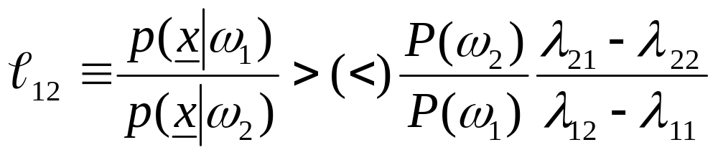
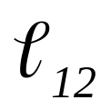
CLASSIFIERS BASED ON BAYES DECISION THEORY
Choose and so that r is minimized
Then assign to if
Equivalently:
assign x in if
: likelihood ratio

Slide 16
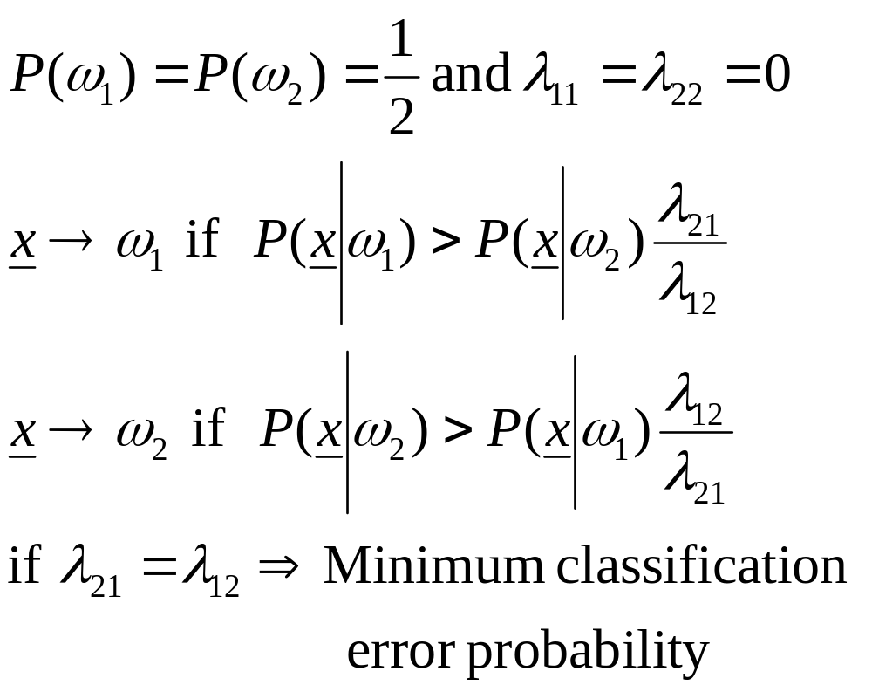
CLASSIFIERS BASED ON BAYES DECISION THEORY
If

Slide 17
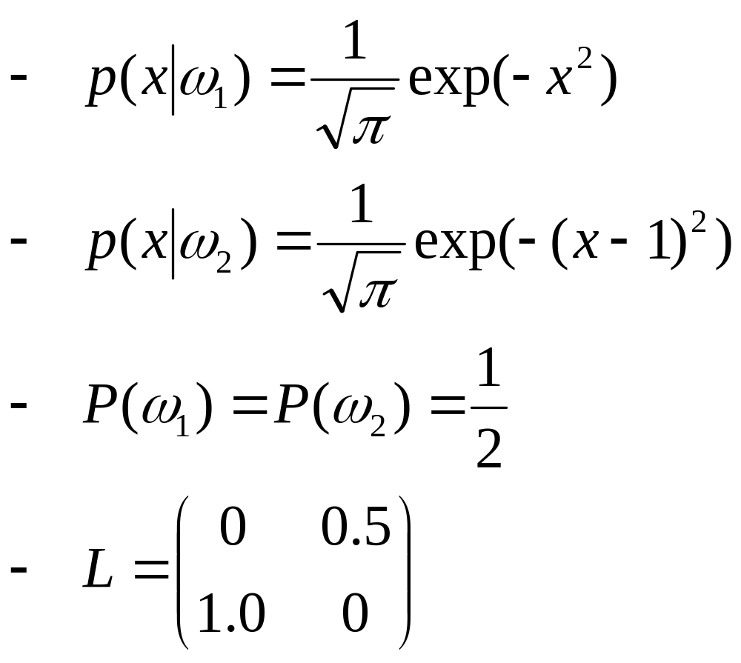
CLASSIFIERS BASED ON BAYES DECISION THEORY
An example:

Slide 18
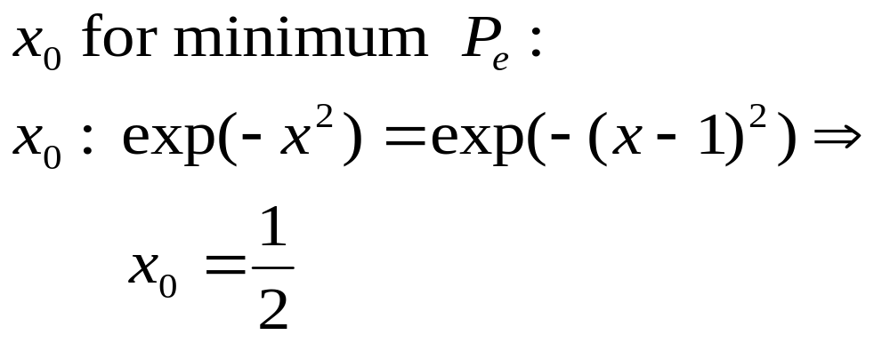
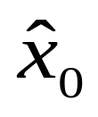
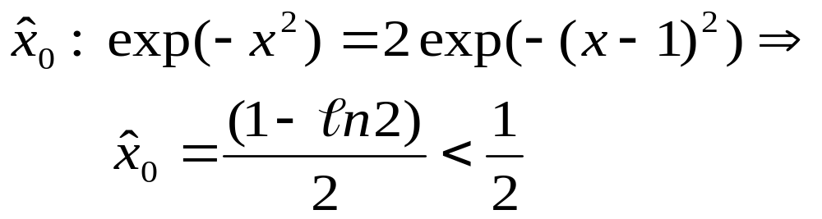
CLASSIFIERS BASED ON BAYES DECISION THEORY
  Then the threshold value is:
  Threshold for minimum r

Slide 19
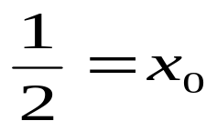
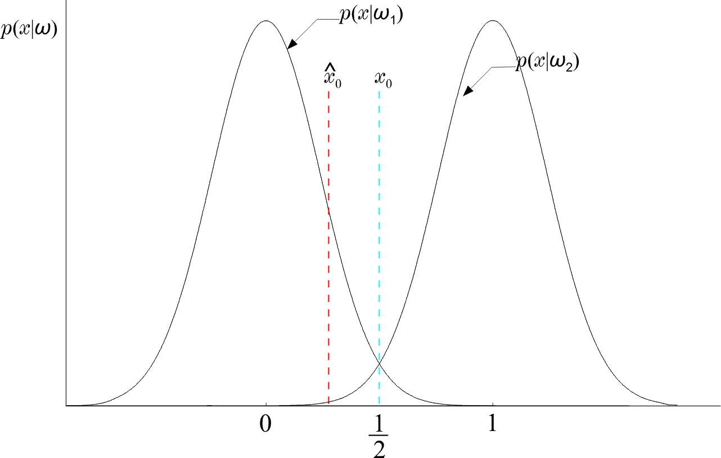
CLASSIFIERS BASED ON BAYES DECISION THEORY
  Thus moves to the left of
  (WHY?)

Slide 20
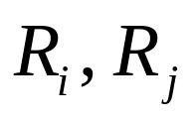
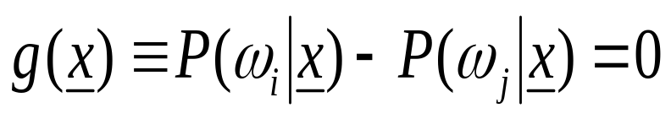
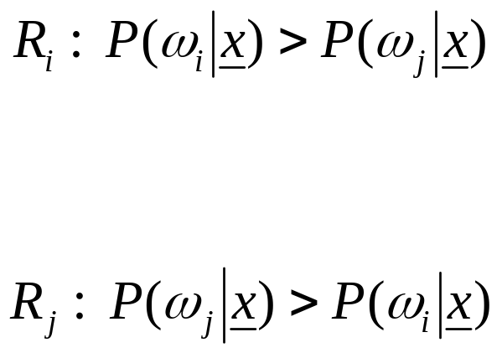

DISCRIMINANT FUNCTIONS DECISION SURFACES
If are contiguous:
is the surface separating the regions. On one side is positive (+), on the other is negative (-). It is known as Decision Surface
+
-

Slide 21
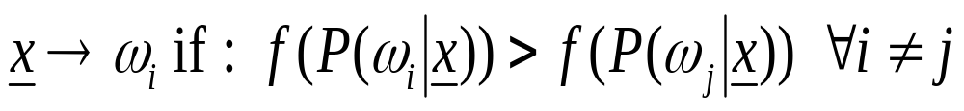
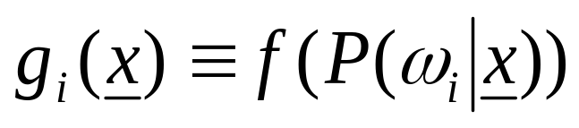
DISCRIMINANT FUNCTIONS DECISION SURFACES
If f(.) monotonic, the rule remains the same if we use:
is a discriminant function
In general, discriminant functions can be defined independent of the Bayesian rule. They lead to suboptimal solutions, yet if chosen appropriately, can be computationally more tractable.
SSWT

Slide 22
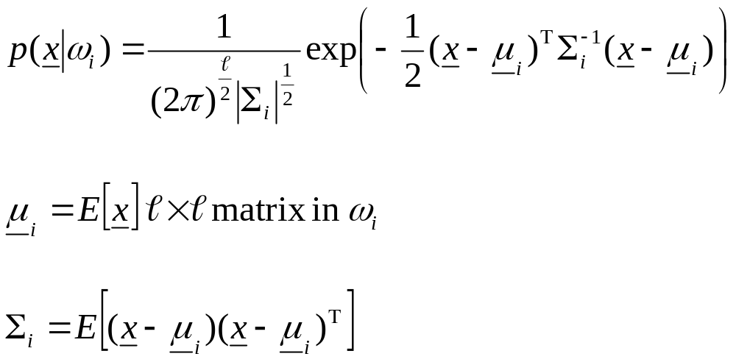
BAYESIAN CLASSIFIER FOR NORMAL DISTRIBUTIONS
Multivariate Gaussian pdf
  called covariance matrix

Slide 23
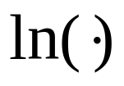
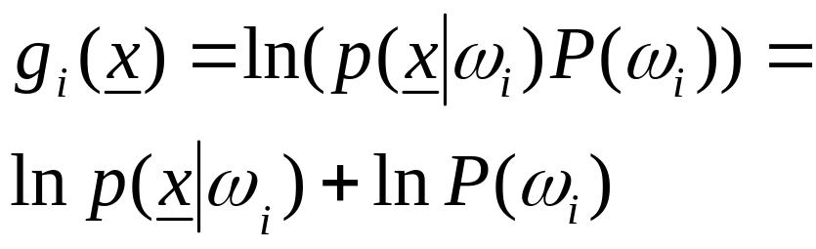
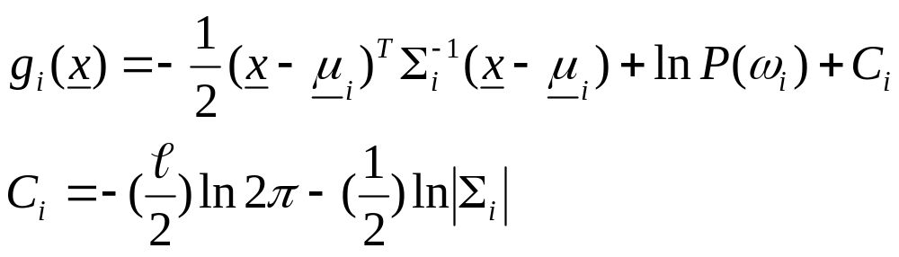
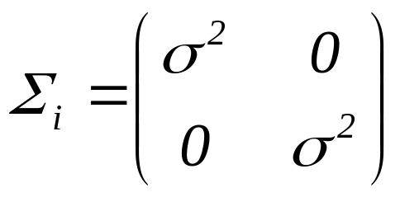
BAYESIAN CLASSIFIER FOR NORMAL DISTRIBUTIONS
is monotonic. Define:
  Example:

Slide 24
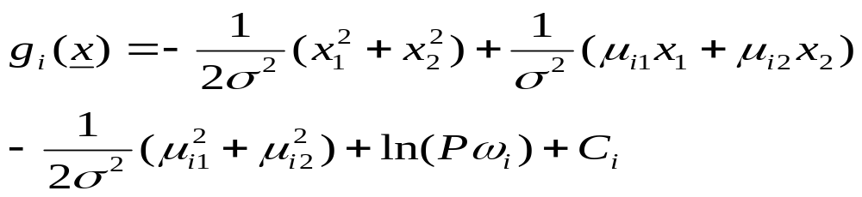


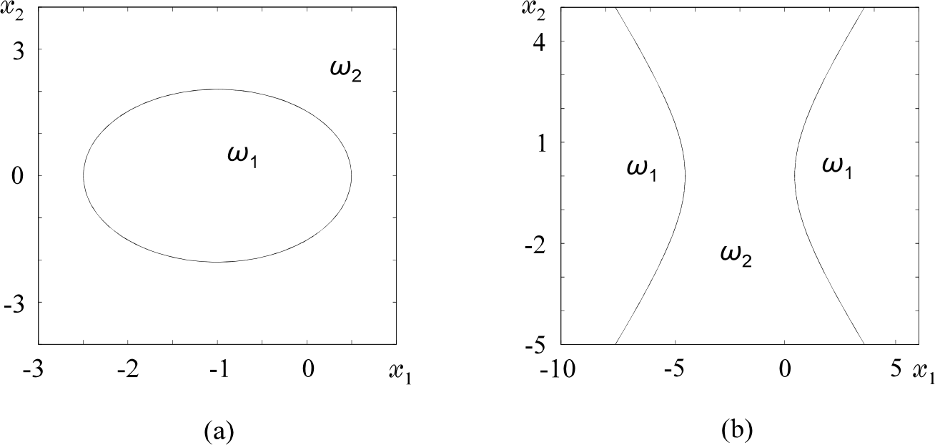
BAYESIAN CLASSIFIER FOR NORMAL DISTRIBUTIONS
  That is, is quadratic and the surfaces
    quadrics, ellipsoids, parabolas, hyperbolas,
    pairs of lines.
  For example:

Slide 25
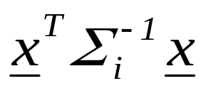
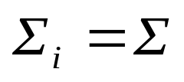
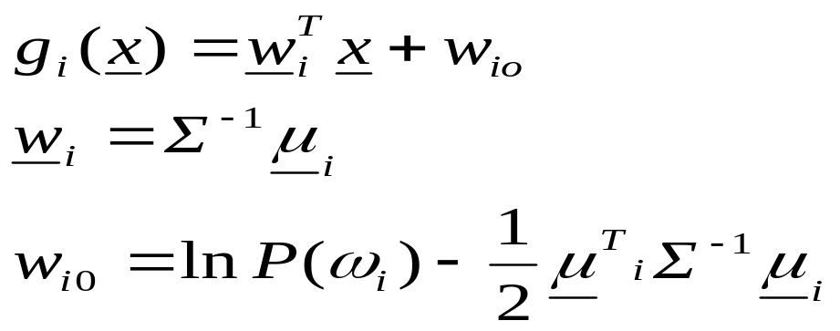
BAYESIAN CLASSIFIER FOR NORMAL DISTRIBUTIONS
Decision Hyperplanes
  Quadratic terms:
  If ALL (the same) the quadratic terms are not of interest. They are not involved in comparisons. Then, equivalently, we can write:
  Discriminant functions are LINEAR

Slide 26


BAYESIAN CLASSIFIER FOR NORMAL DISTRIBUTIONS
  Let in addition:

Slide 27





BAYESIAN CLASSIFIER FOR NORMAL DISTRIBUTIONS
  Nondiagonal:
  Decision hyperplane

Slide 28






BAYESIAN CLASSIFIER FOR NORMAL DISTRIBUTIONS
Minimum Distance Classifiers
  equiprobable
  Euclidean Distance:
  smaller
  Mahalanobis Distance:
  smaller

Slide 29

BAYESIAN CLASSIFIER FOR NORMAL DISTRIBUTIONS

Slide 30



BAYESIAN CLASSIFIER FOR NORMAL DISTRIBUTIONS
Example:

Slide 31
ESTIMATION OF
UNKNOWN PROBABILITY
DENSITY FUNCTIONS
Parametric Methods
  Maximum likelihood
  Maximum a posteriori probability
  Bayesian inference
  Maximum entropy
  Mixture models
Non-parametric Methods

Slide 32

ESTIMATION OF UNKNOWN PROBABILITY
DENSITY FUNCTIONS
Maximum Likelihood

Slide 33

ESTIMATION OF UNKNOWN PROBABILITY
DENSITY FUNCTIONS

Slide 34

ESTIMATION OF UNKNOWN PROBABILITY
DENSITY FUNCTIONS

Slide 35

ESTIMATION OF UNKNOWN PROBABILITY
DENSITY FUNCTIONS
  Asymptotically unbiased and consistent

Slide 36

ESTIMATION OF UNKNOWN PROBABILITY
DENSITY FUNCTIONS
Example:

Slide 37



ESTIMATION OF UNKNOWN PROBABILITY
DENSITY FUNCTIONS
Maximum a posteriori (MAP) probability estimation
  In ML method, θ was considered as a parameter
  Here we shall look at θ as a random vector described by a pdf p(θ), assumed to be known
  Given
  Compute the maximum of
  From Bayes theorem

Slide 38

ESTIMATION OF UNKNOWN PROBABILITY
DENSITY FUNCTIONS
  The method:

Slide 39

ESTIMATION OF UNKNOWN PROBABILITY
DENSITY FUNCTIONS

Slide 40

ESTIMATION OF UNKNOWN PROBABILITY
DENSITY FUNCTIONS
Example:

Slide 41

Bayesian Inference
Bayesian Inference

Slide 42


Bayesian Inference

Slide 43


Bayesian Inference
  The above is a sequence of Gaussians as

Slide 44


ESTIMATION OF UNKNOWN PROBABILITY
DENSITY FUNCTIONS
Maximum Entropy
  Entropy

Slide 45




ESTIMATION OF UNKNOWN PROBABILITY
DENSITY FUNCTIONS
  Example: x is nonzero in the interval
  and zero otherwise. Compute the ME pdf
    The constraint:
    Lagrange Multipliers

Slide 46





ESTIMATION OF UNKNOWN PROBABILITY
DENSITY FUNCTIONS
Mixture Models
  Assume parametric modeling, i.e.,
  The goal is to estimate
    given a set
  Why not ML? As before?

Slide 47
Expectation-Maximisation
  This is a nonlinear problem due to the missing label information. This is a typical problem with an incomplete data set.
  The Expectation-Maximisation (EM) algorithm.
    General formulation
      which are not observed directly.
      We observe
    a many to one transformation

Slide 48




Expectation-Maximisation
    Let
    What we need is to compute
    But are not observed. Here comes the EM. Maximize the expectation of the loglikelihood conditioned on the observed samples and the current iteration estimate of

Slide 49






Expectation-Maximisation
  The algorithm:
    E-step:
    M-step:
  Application to the mixture modeling problem
    Complete data
    Observed data
    Assuming mutual independence

Slide 50



Expectation-Maximisation
    Unknown parameters
    E-step
    M-step

Slide 51




Nonparametric Estimation
Nonparametric Estimation

Slide 52

Nonparametric Estimation
Parzen Windows
  Divide the multidimensional space in hypercubes

Slide 53





Nonparametric Estimation
  Define
    That is, it is 1 inside a unit side hypercube centered at 0
    The problem:
    Parzen windows-kernels-potential functions

Slide 54





Nonparametric Estimation
  Mean value
    Hence unbiased in the limit

Slide 55

Nonparametric Estimation
  Variance
    The smaller the h the higher the variance
h=0.1, N=1000
h=0.8, N=1000

Slide 56

Nonparametric Estimation
h=0.1, N=10000
  The higher the N the better the accuracy

Slide 57



Nonparametric Estimation
  If
  asymptotically unbiased
  The method
    Remember:

Slide 58
Nonparametric Estimation
CURSE OF DIMENSIONALITY
  In all the methods, so far, we saw that the highest the number of points, N, the better the resulting estimate.
  If in the one-dimensional space an interval, filled with N points, is adequately (for good estimation), in the two-dimensional space the corresponding square will require N² and in the ℓ-dimensional space the ℓ-dimensional cube will require N^{ℓ} points.
  The exponential increase in the number of necessary points in known as the curse of dimensionality. This is a major problem one is confronted with in high dimensional spaces.

Slide 59



NAIVE – BAYES
NAIVE – BAYES CLASSIFIER
  Let and the goal is to estimate
  i = 1, 2, …, M. For a “good” estimate of the pdf one would need, say, N^{ℓ} points.
  Assume x₁, x₂ ,…, x_{ℓ} mutually independent. Then:
  In this case, one would require, roughly, N points for each pdf. Thus, a number of points of the order N·ℓ would suffice.
  It turns out that the Naïve – Bayes classifier works reasonably well even in cases that violate the independence assumption.

Slide 60


Clustering: k-means
K Nearest Neighbor Density Estimation
  In Parzen:
    The volume is constant
    The number of points in the volume is varying
  Now:
    Keep the number of points
    constant
    Leave the volume to be varying

Slide 61


ESTIMATION OF UNKNOWN PROBABILITY
DENSITY FUNCTIONS

Slide 62


Clustering: k-means
The Nearest Neighbor Rule
  Choose k out of the N training vectors, identify the k nearest ones to x
  Out of these k identify k_{i} that belong to class ω_{i}
  The simplest version
  k=1 !!!
  For large N this is not bad. It can be shown that:
  if P_{B} is the optimal Bayesian error probability, then:

Slide 63



Clustering: k-means
  For small P_{B}:

Slide 64


Clustering: k-means
Voronoi tesselation

Slide 65



Clustering: k-means
Bayes Probability Chain Rule
  Assume now that the conditional dependence for each x_{i} is limited to a subset of the features appearing in each of the product terms. That is:
  where

Slide 66


Clustering: k-means
  For example, if ℓ=6, then we could assume:
  Then:
  The above is a generalization of the Naïve – Bayes. For the Naïve – Bayes the assumption is:
  A_{i} = Ø, for i=1, 2, …, ℓ

Slide 67

Clustering: k-means
  A graphical way to portray conditional dependencies is given below
  According to this figure we have that:
    x₆ is conditionally dependent on x₄, x₅.
    x₅ on x₄
    x₄ on x₁, x₂
    x₃ on x₂
    x₁, x₂ are conditionally independent on other variables.
  For this case:

Slide 68
BAYESIAN NETWORKS
Bayesian Networks
  Definition: A Bayesian Network is a directed acyclic graph (DAG) where the nodes correspond to random variables. Each node is associated with a set of conditional probabilities (densities), p(x_{i}|A_{i}), where x_{i} is the variable associated with the node and A_{i} is the set of its parents in the graph.
  A Bayesian Network is specified by:
    The marginal probabilities of its root nodes.
    The conditional probabilities of the non-root nodes, given their parents, for ALL possible combinations.

Slide 69

BAYESIAN NETWORKS
  The figure below is an example of a Bayesian Network corresponding to a paradigm from the medical applications field.
  This Bayesian network models conditional dependencies for an example concerning smokers (S), tendencies to develop cancer (C) and heart disease (H), together with variables corresponding to heart (H1, H2) and cancer (C1, C2) medical tests.

Slide 70
BAYESIAN NETWORKS
  Once a DAG has been constructed, the joint probability can be obtained by multiplying the marginal (root nodes) and the conditional (non-root nodes) probabilities.
  Training: Once a topology is given, probabilities are estimated via the training data set. There are also methods that learn the topology.
  Probability Inference: This is the most common task that Bayesian networks help us to solve efficiently. Given the values of some of the variables in the graph, known as evidence, the goal is to compute the conditional probabilities for some of the other variables, given the evidence.

Slide 71

BAYESIAN NETWORKS
Example: Consider the Bayesian network of the figure:
a) If x is measured to be x=1 (x1), compute P(w=0|x=1) [P(w0|x1)].
b) If w is measured to be w=1 (w1) compute P(x=0|w=1) [ P(x0|w1)].

Slide 72
BAYESIAN NETWORKS
  For a), a set of calculations are required that propagate from node x to node w. It turns out that P(w0|x1) = 0.63.
  For b), the propagation is reversed in direction. It turns out that P(x0|w1) = 0.4.
  In general, the required inference information is computed via a combined process of “message passing” among the nodes of the DAG.
Complexity:
  For singly connected graphs, message passing algorithms amount to a complexity linear in the number of nodes.

Slide 73



Q&A

